Slide 1

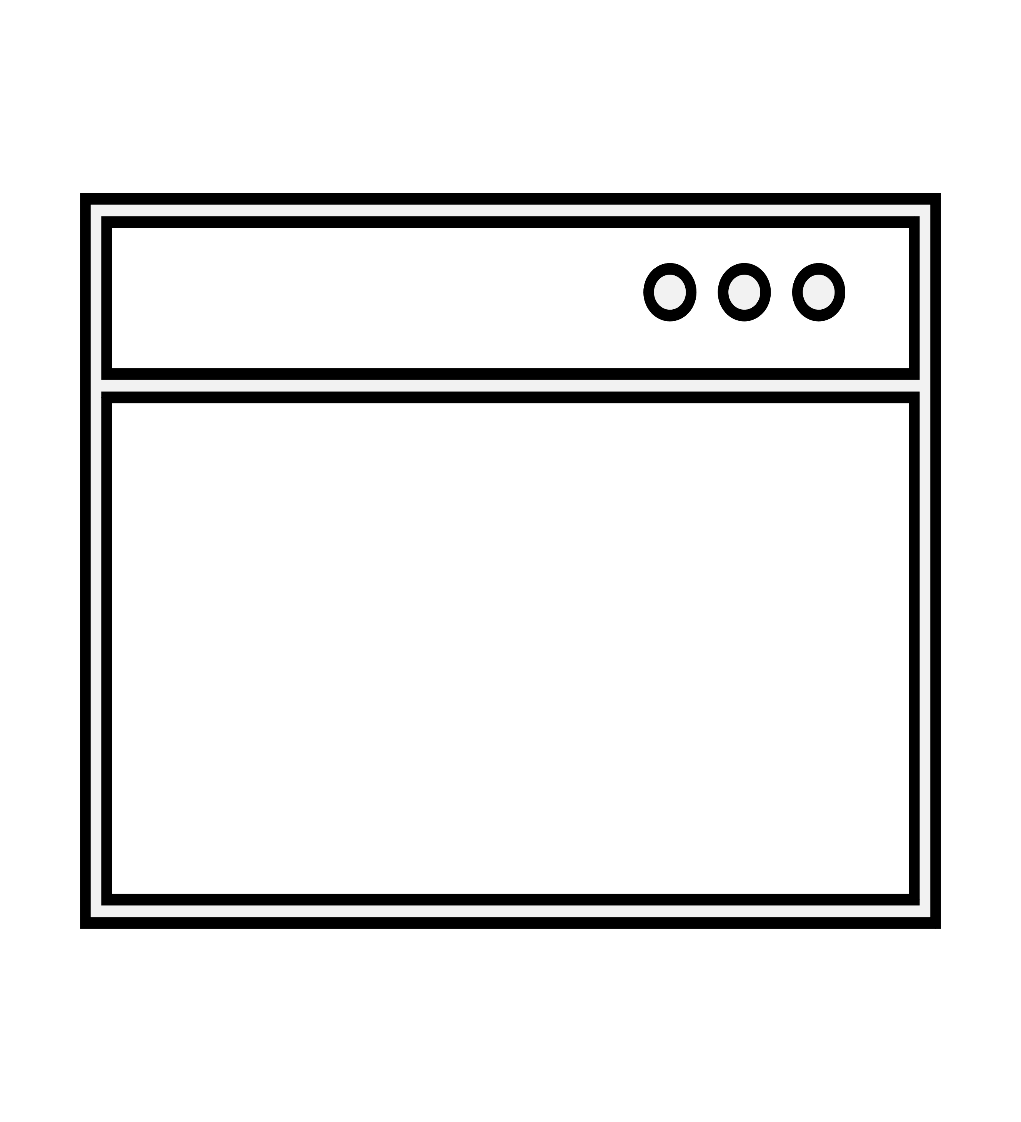



Admin Panel
View Users
https://vulnerable-website.com/login.jsp?admin=true
Delete Users
Add Users
Broken Access Control
Author: Rana Khalil (
@rana khalil)

Slide 2




Agenda
Author: Rana Khalil (
@rana khalil)
WHAT IS BROKEN ACCESS CONTROL?
HOW DO YOU FIND IT?
HOW DO YOU EXPLOIT IT?
HOW DO YOU PREVENT IT?

Slide 3

WHAT IS BROKEN ACCESS CONTROL?
Author: Rana Khalil (
@rana khalil)

Slide 4
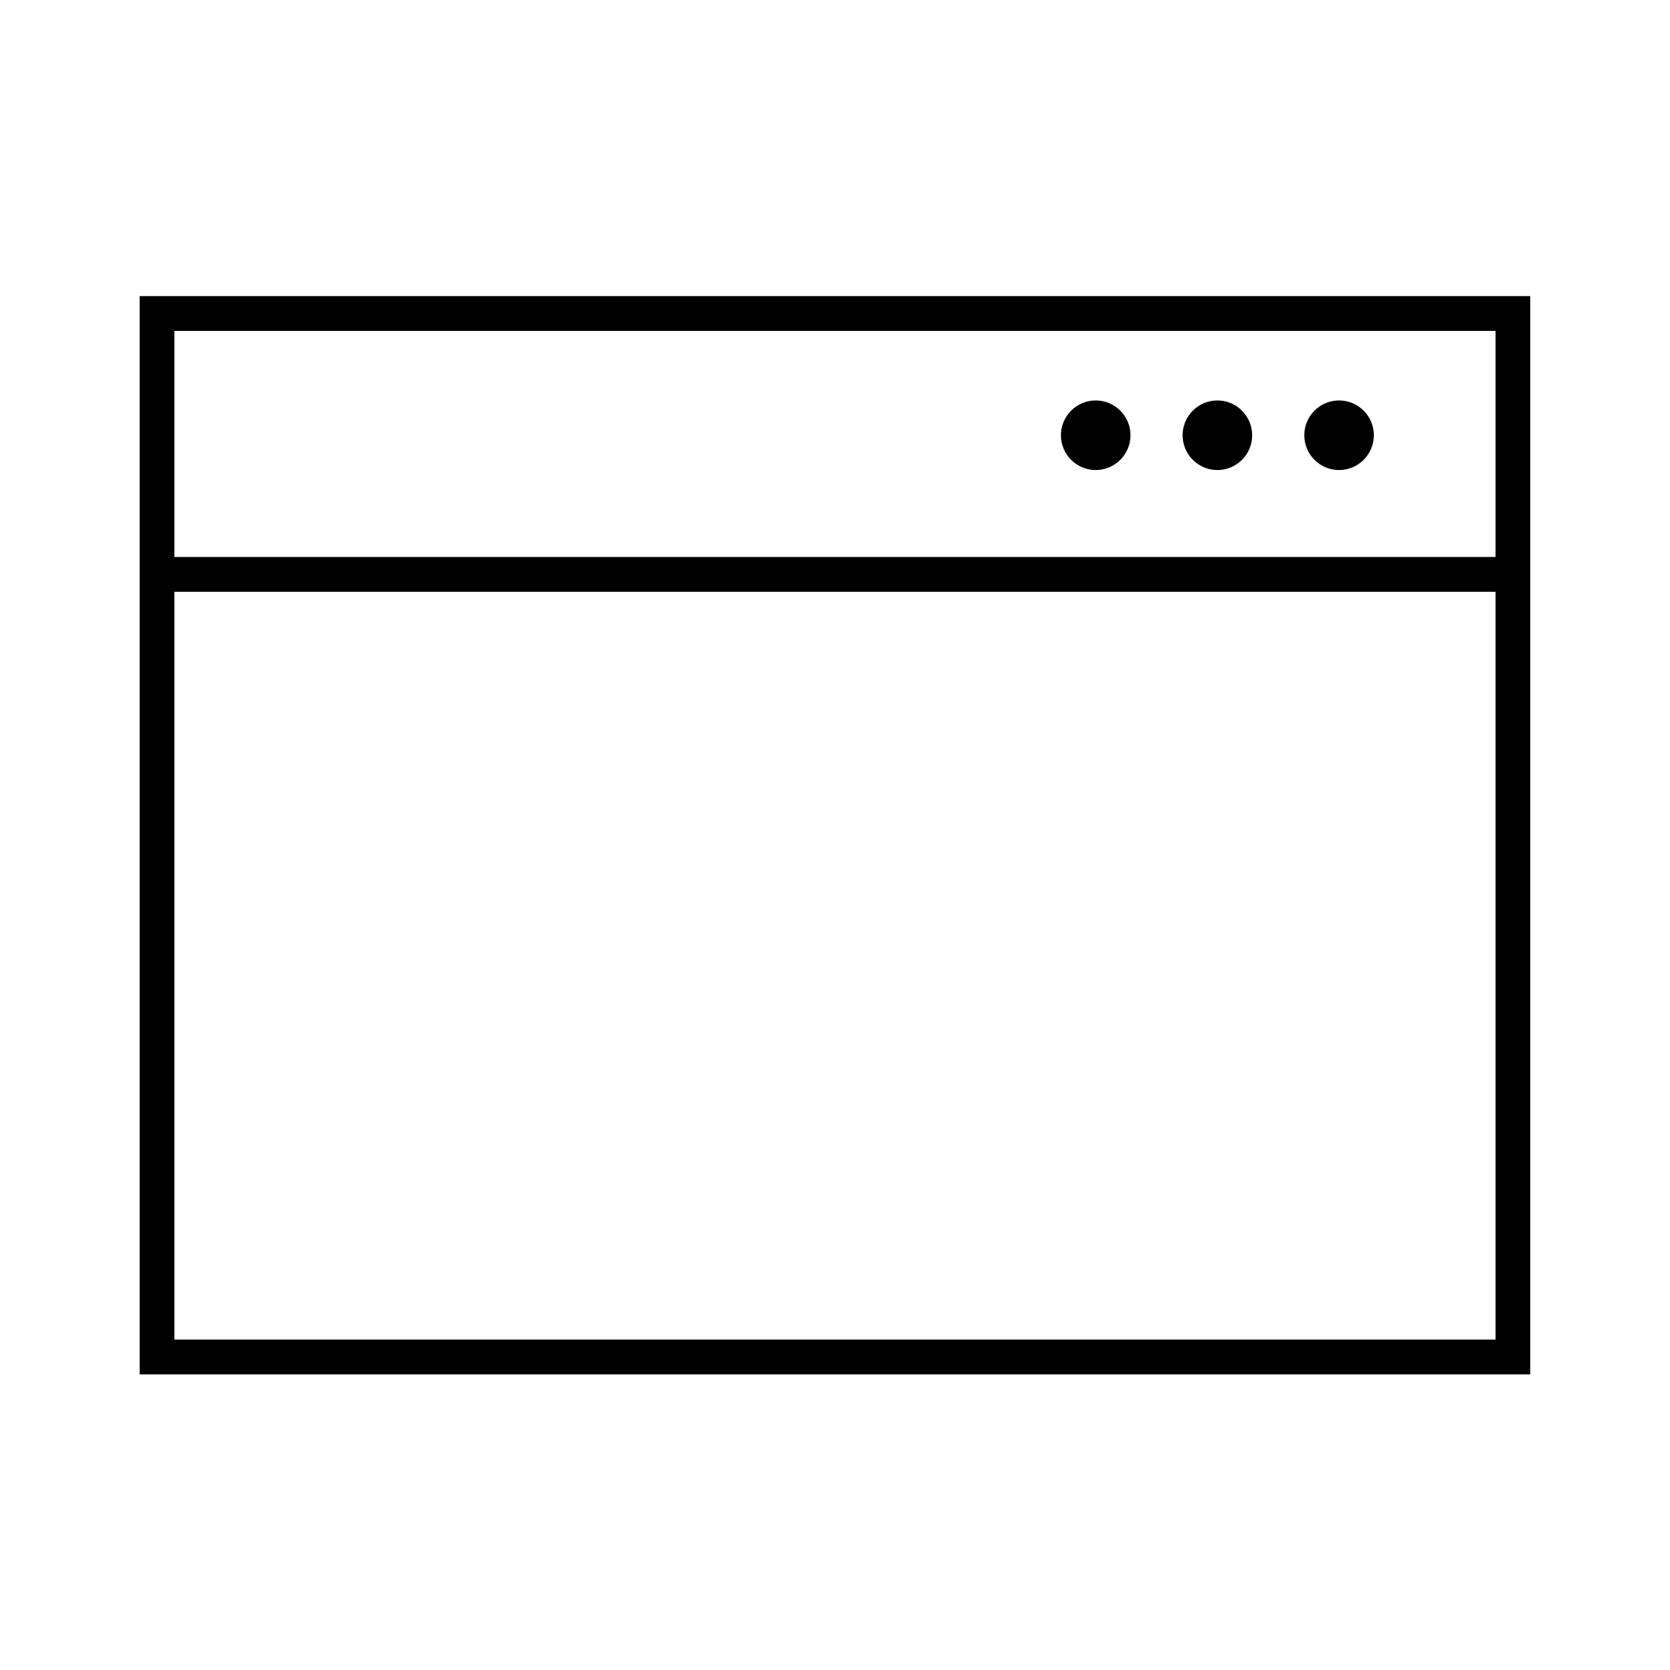

Some Terminology...
Authentication identifies the user and confirms that they say who they say they are.
1
admin/admin
Username
Password
Log In
4
@rana khalil

Slide 5

Some Terminology...
Session Management identifies which subsequent HTTP requests are being made by each user.
1
admin/admin
2 Set-Cookie: session=66htna8ujukmhj
Username
Password
Log In
5
@rana khalil

Slide 6

Some Terminology...
Session Management identifies which subsequent HTTP requests are being made by each user.
Welcome Admin!
3
session=66htna8ujukmhj
6
@rana khalil

Slide 7

Some Terminology...
Access Control determines whether the user is allowed to carry out the action that they are attempting to perform.
4
Welcome Admin!
3
session=66htna8ujukmhj
7
@rana khalil

Slide 8



Some Terminology...
Three different types of access control:
Vertical Access Control is used to restrict access to functions not available for other users in the organization.
Admin
Regular User
8
@rana khalil

Slide 9



Some Terminology...
Three different types of access control:
Horizontal Access Control enables different users to access similar resource types.
Regular User #1
Regular User #2
9
@rana khalil

Slide 10
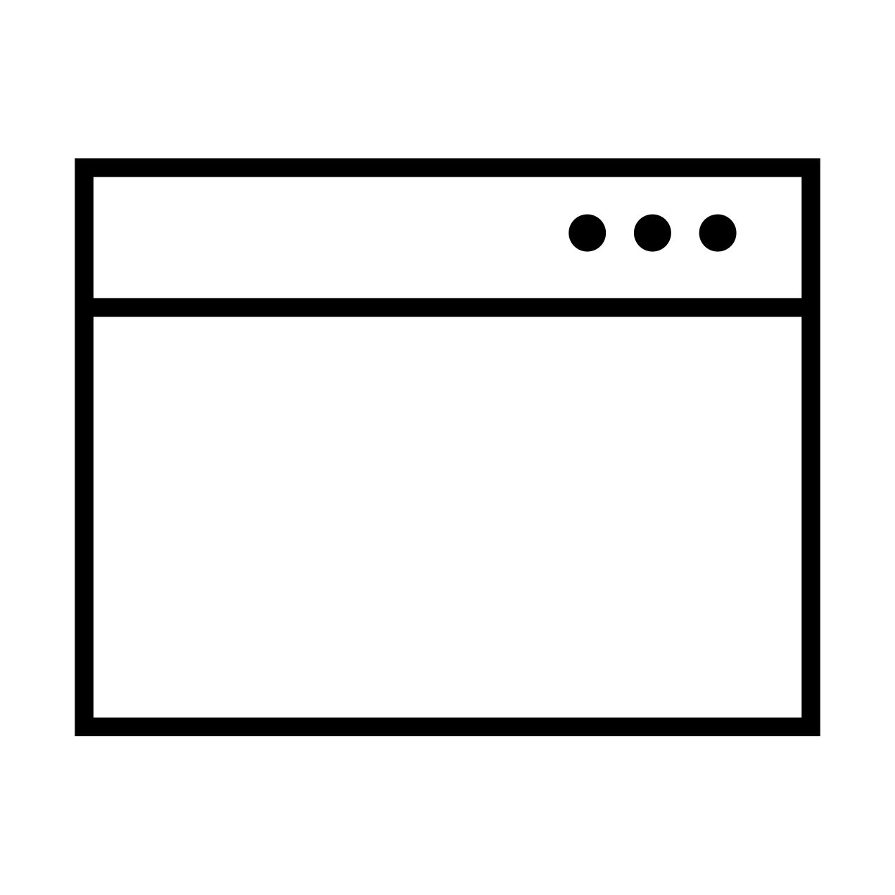
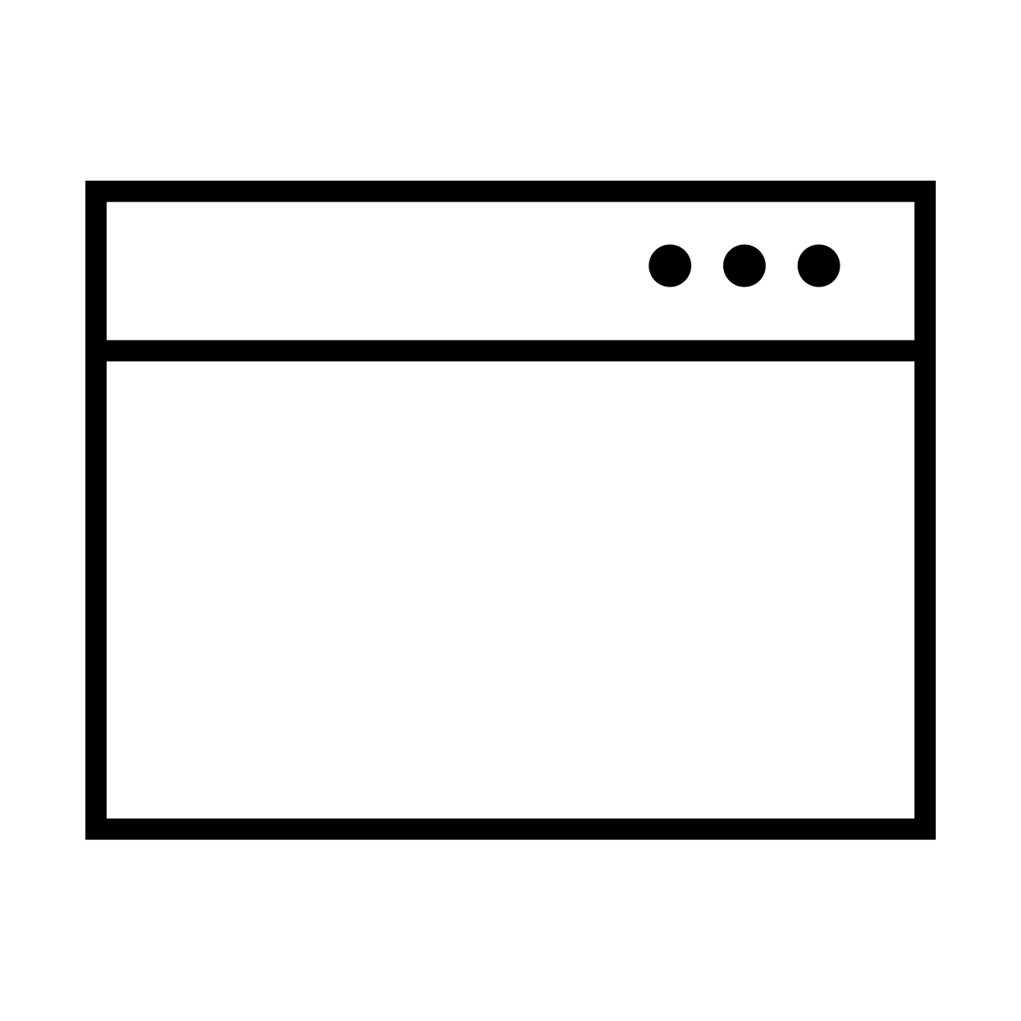
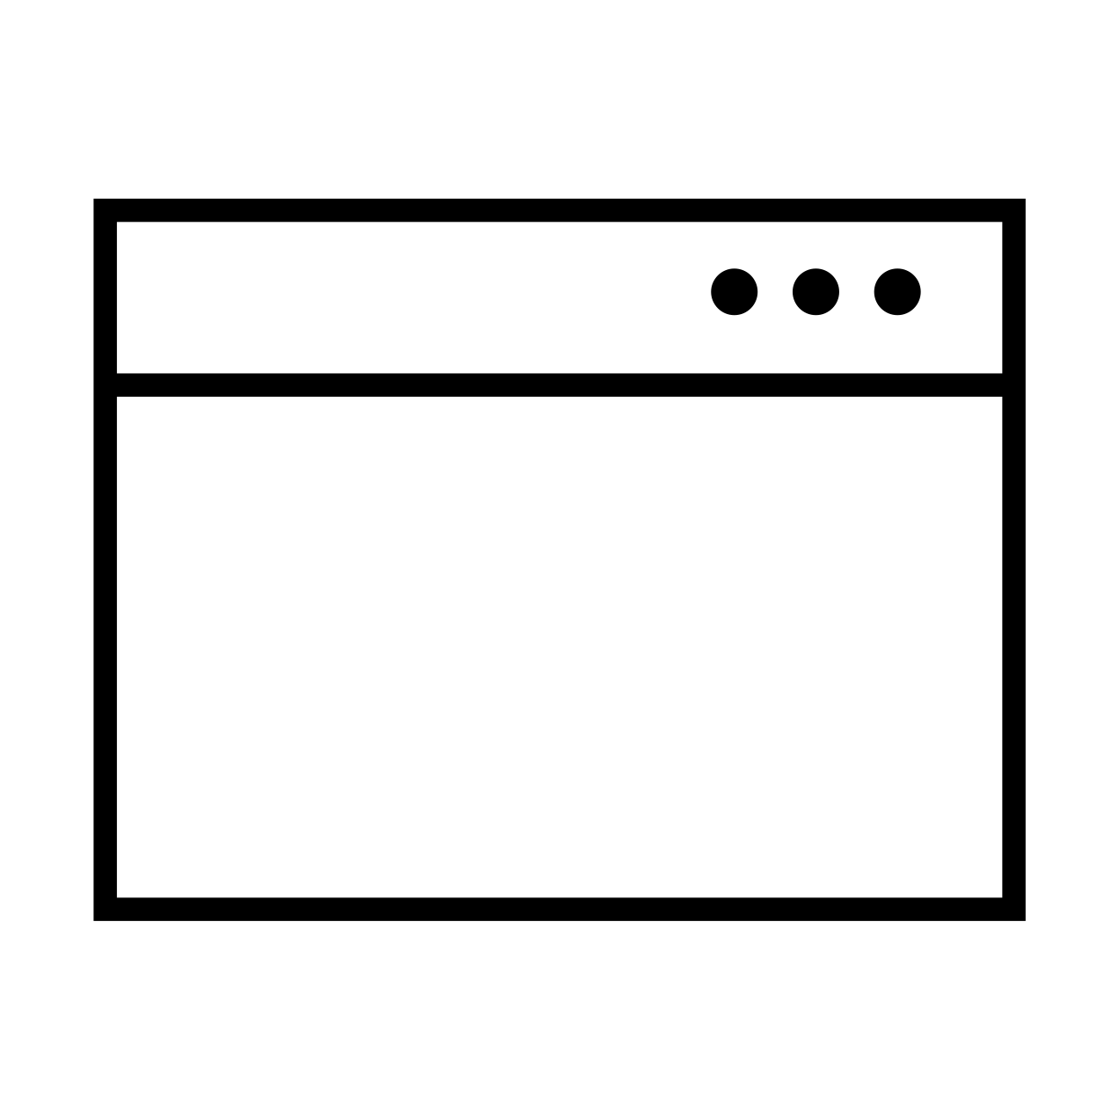

Some Terminology...
Three different types of access control:
Context-Dependent Access Control restricts access to functionality and resources based on the state of the application or the user's interaction with it.
1
/confirm
Confirmation
Are you sure you want to delete the user Carlos?
Yes No
2
/delete
Delete Users
Carlos
David
User Successfully Deleted.
Delete
Delete
10
@rana khalil

Slide 11

Broken Access Control vulnerabilities arise when users can act outside of their intended permissions. This typically leads to sensitive information disclosure, unauthorized access and modification or destruction of data.
11
@rana khalil

Slide 12


Horizontal Privilege Escalation
Horizontal privilege escalation occurs when an attacker gains access to resources belonging to another user of the same privilege level.
Alice
Web Application
https://vulnerable-website.com/myaccount?id=1₂₃
Hello, Alice!
Bank Account | Amount
Chequing Accounts | $4352
Savings Account | $6723
Attacker
https://vulnerable-website^{.com/myaccount?id=123}
12
@rana khalil

Slide 13

Vertical Privilege Escalation
Vertical privilege escalation occurs when an attacker gains access to privileged functionality that they are not permitted to access.
Administrator
Web Application
https://vulnerable-website.com/login/home.jsp?_{admin=true}
Admin Panel
View Users
Attacker
Delete Users
Add Users
https://vulnerable-website.com/login/home.jsp?admin=true
13
@rana khalil

Slide 14
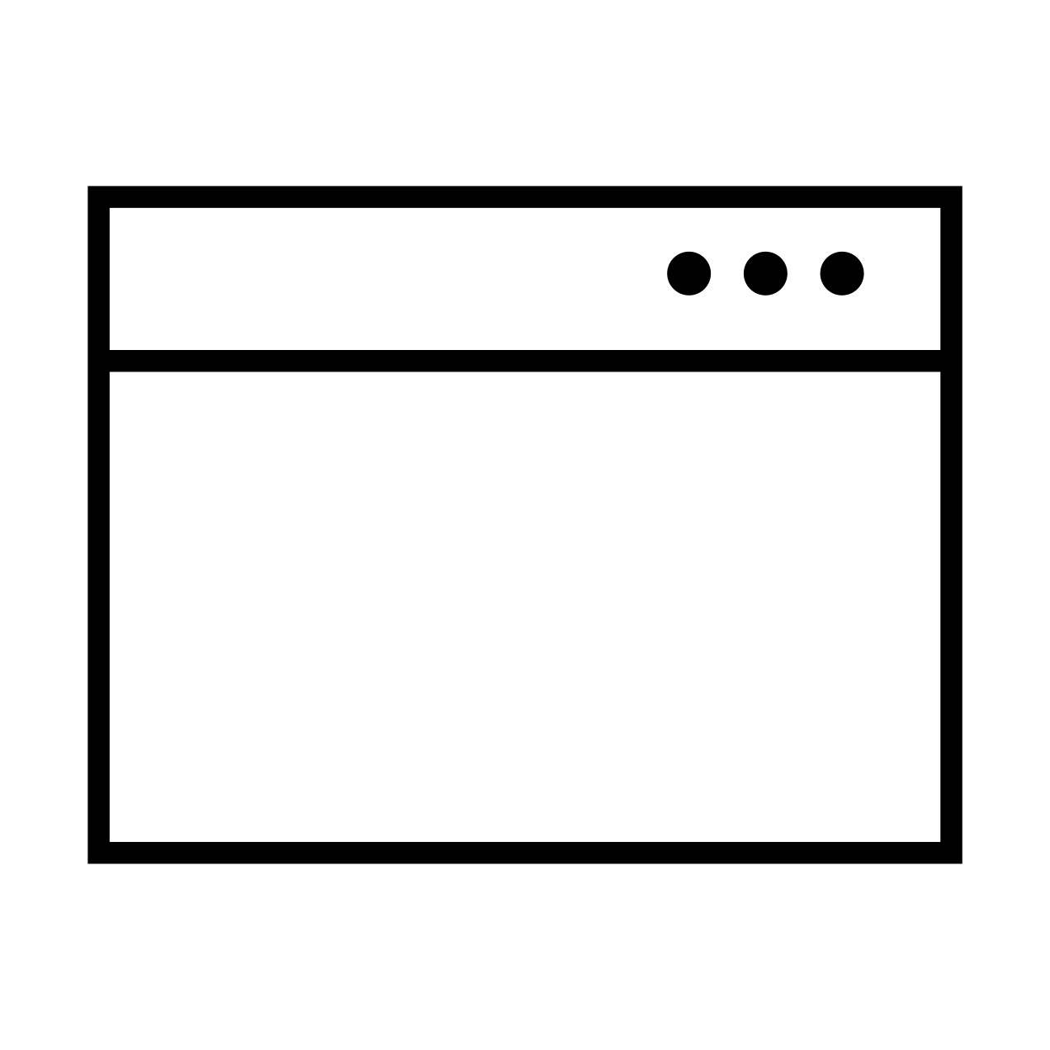
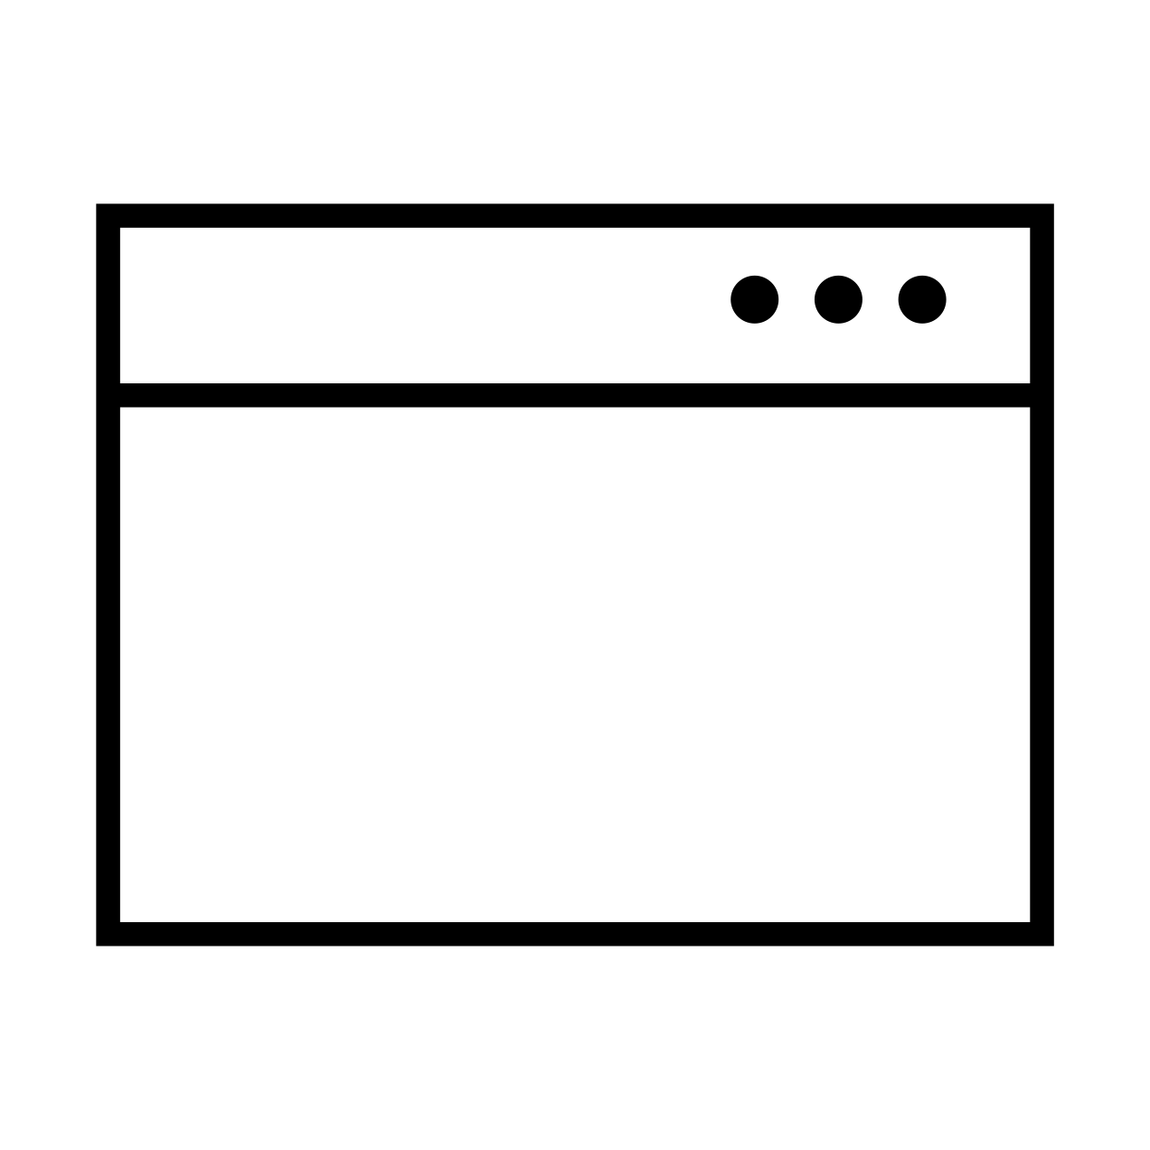
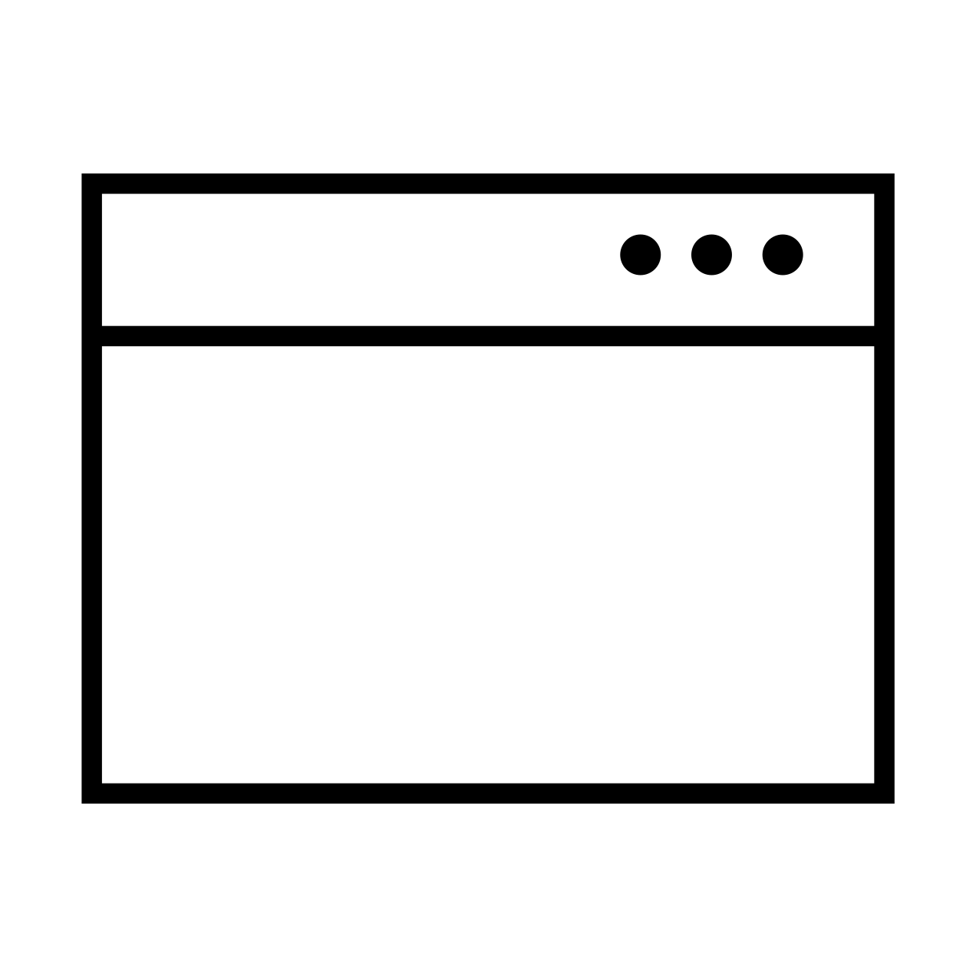
Access Control Vulnerabilities in Multi-Step
Processes
These type of vulnerabilities occur when access control rules are implemented on some of the steps, but ignored on others.
1
/confirm
Confirmation
Are you sure you want to delete the user Carlos?
Yes No
2
/delete
Delete Users
User Successfully Deleted.
Carlos
David
Delete
Delete
14
@rana khalil

Slide 15
Other Access Control Examples
Bypassing access control checks by modifying parameters in the URL or HTML page.
Accessing the API with missing access controls on the POST, PUT and DELETE methods.
Manipulating metadata, such as replaying or tampering with JSON Web
Tokens (JWTs) or a cookie.
Exploiting CORS misconfiguration that allow API access from unauthorized / untrusted origins.
Force browsing to authenticated pages as an unauthenticated user.
15
@rana khalil

Slide 16
Spot the Vulnerability?
public boolean deleteOrder(Long id) {
Order order = orderRepository.getOne(id);
if (order == null) {
log.info("No found order");
return false;
6 }
User user = order.getUser();
orderRepository.delete(order);
log.info("Delete order for user {}", user.getId());
return true;
11 }
Answer: No verification is performed on line 8 to see if the order has been made by the currently logged-in user.
How do you fix this code?
Answer: Ensure the object id of the order belongs to the user making the request.
Code Source: : https://www.securecodewarrior.com/blog/coders-conquer-security-owasp-top-10-api-series-broken-object-level-authorization
16
@rana khalil

Slide 17
Impact of Access Control Vulnerabilities
Unauthorized access to the application.
Confidentiality – Access to other users’ data.
Integrity – Access to update other users’ data
Availability – Access to delete users.
Can sometimes be chained with other vulnerabilities to gain remote code execution on the host operating system.
17
@rana khalil

Slide 18

OWASP Top 10
Author: Rana Khalil (
@rana khalil)
OWASP Top 10 - 2013 | OWASP Top 10 - 2017 | OWASP Top 10 - 2021
A1 – Injection | A1 – Injection | A1 – Broken Access Control
A2 – Broken Authentication and Session Management | A2 – Broken Authentication | A2 – Cryptographic Failures
A3 – Cross-Site Scripting (XSS) | A3 – Sensitive Data Exposure | A3 - Injection
A4 – Insecure Direct Object References | A4 – XML External Entities (XXE) | A4 – Insecure Design
A5 – Security Misconfiguration | A5 – Broken Access Control | A5 – Security Misconfiguration
A6 – Sensitive Data Exposure | A6 – Security Misconfiguration | A6 – Vulnerable and Outdated Components
A7 – Missing Function Level Access Control | A7 – Cross-Site Scripting (XSS) | A7 – Identification and Authentication Failures
A8 – Cross-Site Request Forgery (CSRF) | A8 – Insecure Deserialization | A8 – Software and Data Integrity Failures
A9 – Using Components with Known Vulnerabilities | A9 – Using Components with Known Vulnerabilities | A9 – Security Logging and Monitoring Failures
A10 – Unvalidated Redirects and Forwards | A10 – Insufficient Logging & Monitoring | A10 – Server-Side Request Forgery (SSRF)

Slide 19

HOW TO FIND ACCESS CONTROL VULNERABILITIES?
Author: Rana Khalil (
@rana khalil)

Slide 20
Finding Access Control Vulnerabilities
Author: Rana Khalil (
@rana khalil)
Author: Rana Khalil
Depends on the perspective of testing.
public boolean deleteOrder(Long id) { Order order =
orderRepository.getOne(id); if (order == null) {
log.info("No found order"); return false;
}
User user = order.getUser(); orderRepository.delete(order); log.info("Delete order for user {}",
user.getId());
return true;
Black Box Testing
White Box Testing

Slide 21
Black-Box Testing
Author: Rana Khalil (
@rana khalil)
Map the application.
Identify all instances where the web application appears to be interacting with the underlying operating system.
Understand how access control is implemented for each privilege level.
Manipulate parameters that are potentially used to make access control decisions in the backend.
Automate testing using extensions like Autorize.

Slide 22
White-Box Testing
Author: Rana Khalil (
@rana khalil)
Review the code to identify how access control is implemented in the application.
System defaults to open.
Weak or missing access control checks on functions / resources.
Missing access control rules for POST, PUT and DELETE methods at the API level.
Relying solely on client-side input to perform access control
public boolean deleteOrder(Long id) { Order order =
orderRepository.getOne(id); if (order == null) {
log.info("No found order"); return false;
}
User user = order.getUser(); orderRepository.delete(order); log.info("Delete order for user {}",
user.getId());
return true;
decisions.
Validate potential access control vulnerabilities on a running application.

Slide 23


Author: Rana Khalil (
@rana khalil)
HOW TO EXPLOIT ACCESS CONTROL VULNERABILITIES?

Slide 24
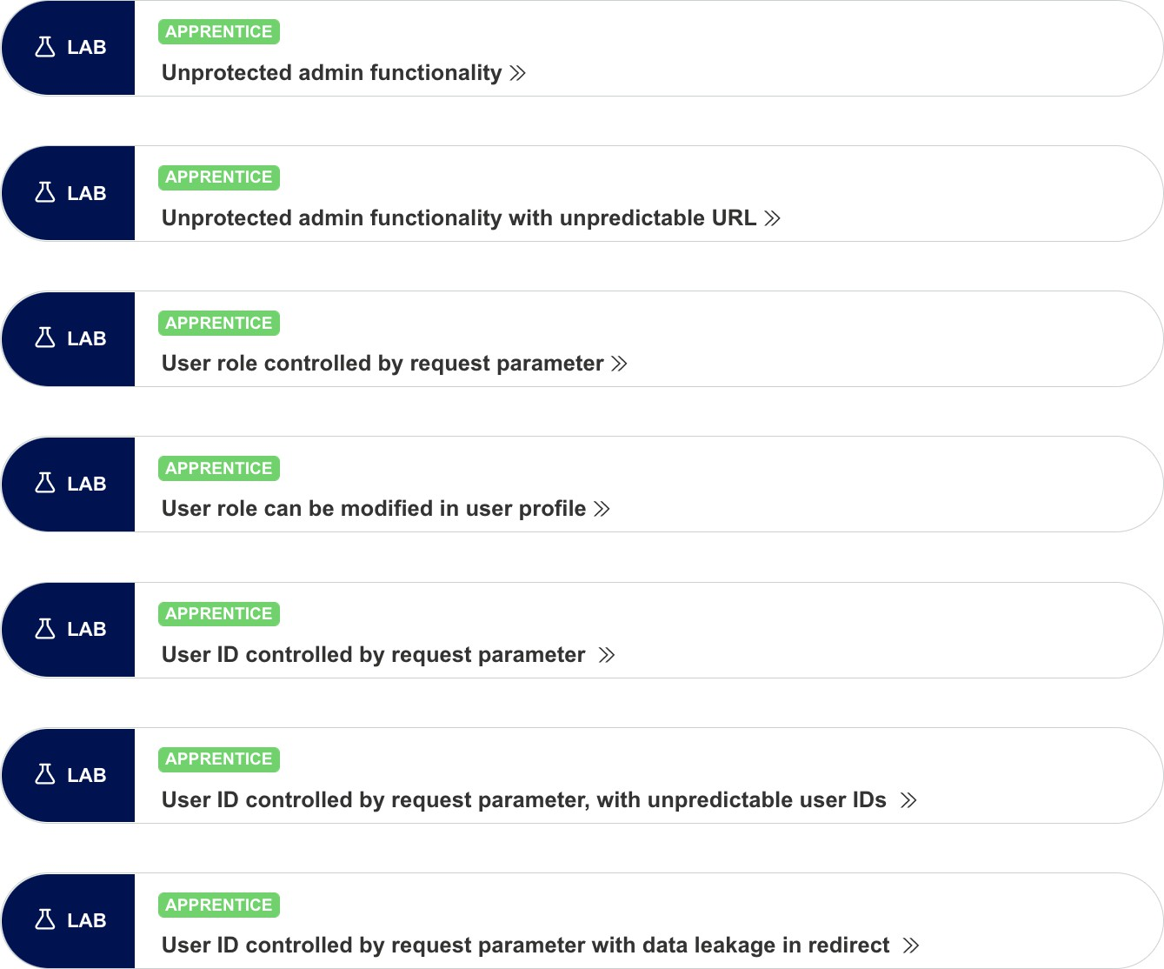
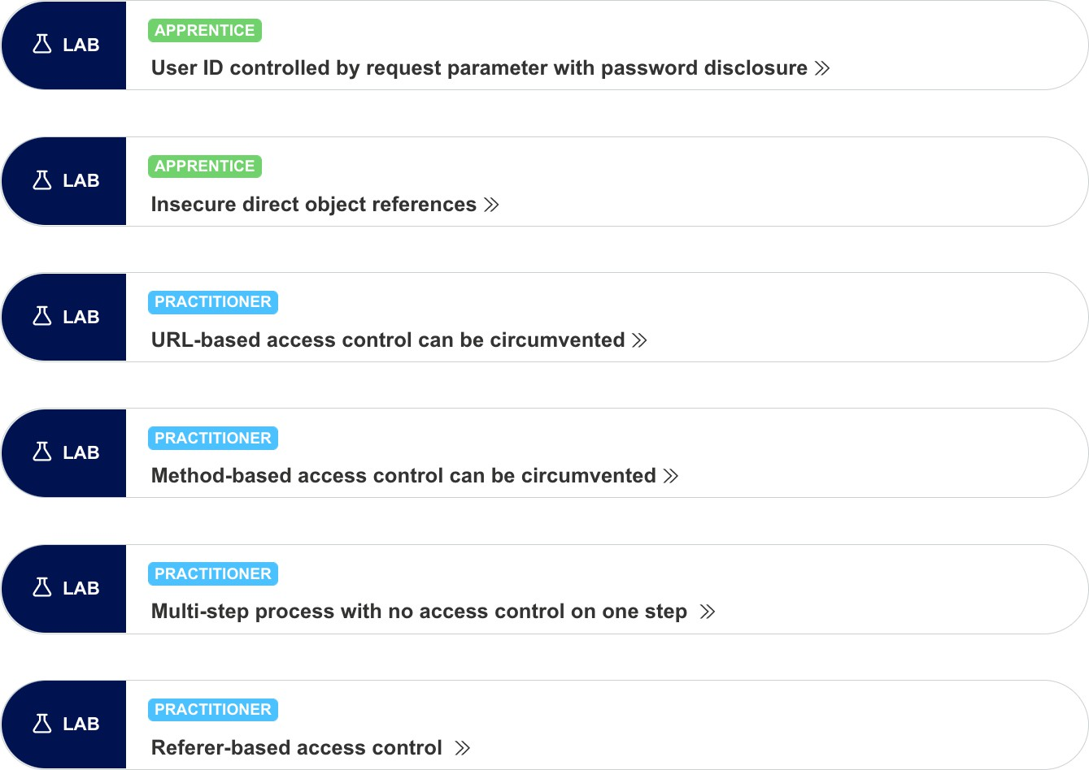
Exploiting Access Control Vulnerabilities
Author: Rana Khalil (
@rana khalil)
Depends on the type of access control vulnerability.
Usually just a matter of manipulated the vulnerable field / parameter.

Slide 25
Automated Exploitation Tools
Author: Rana Khalil (
@rana khalil)
Web Application Vulnerability Scanners (WAVS)

Slide 26

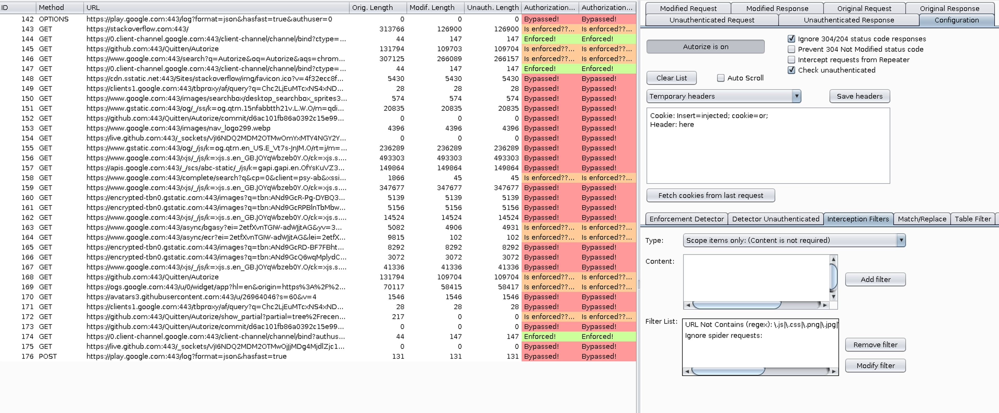
Burp Extension - Autorize
Author: Rana Khalil (
@rana khalil)
Extension Link: : https://portswigger.net/bappstore/f9bbac8c4acf4aefa4d7dc92a991af2f

Slide 27

HOW TO PREVENT ACCESS CONTROL VULNERABILITIES?
Author: Rana Khalil (
@rana khalil)

Slide 28
Preventing Access Control Vulnerabilities
Author: Rana Khalil (
@rana khalil)
Use a security-centric design where access is verified first and ensure all requests go through an access control check.
Except for public resources, deny access by default.
Apply the principal of least privilege throughout the entire application.
Consider using attribute or feature-based access control checks instead of role-based access control.
NIST Attribute Based Access Control https://www.youtube.com/watch?v=cgTa7YnGfHA&ab_channel=NationalInstituteof StandardsandTechnology
NIST Special Publication 800-162: https://nvlpubs.nist.gov/nistpubs/specialpublications/NIST.sp.800-162.pdf
Access control checks should always be performed on the server side.

Slide 29
Resources
Author: Rana Khalil (
@rana khalil)
Web Security Academy – Access Control
https://portswigger.net/web-security/access-control
Web Application Hacker ’s Handbook
Chapter 8 – Attacking Access Controls
OWASP Web Security Testing Guide – Authorization Testing
https://owasp.org/www-project-web-security-testing-guide/v42/4- Web_Application_Security_Testing/05-Authorization_Testing/README
OWASP Top 10 – A01 Broken Access Control
https://owasp.org/Top10/A01_2021-Broken_Access_Control/
OWASP Application Security Verification Standard – V4 Access Control
https://owasp.org/www-pdf-archive/OWASP_Application_Security_Verification_Standard_4.0- en.pdf

